Slide 1
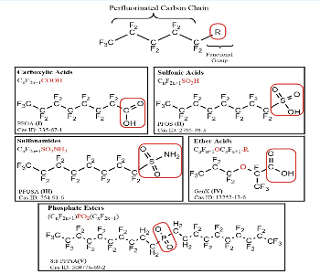
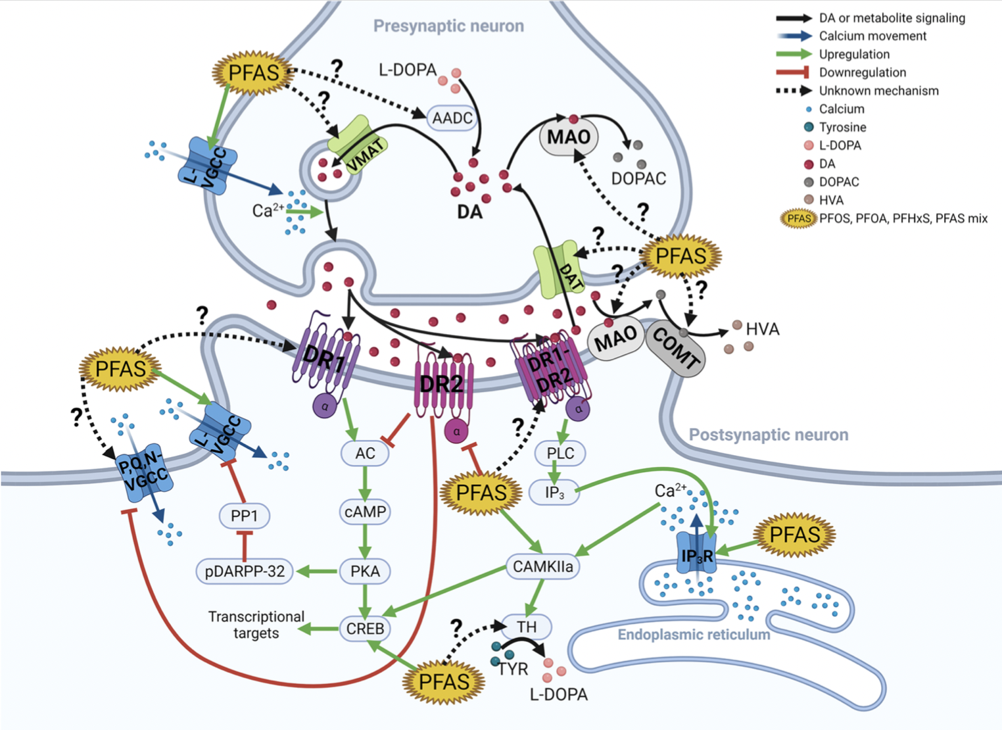
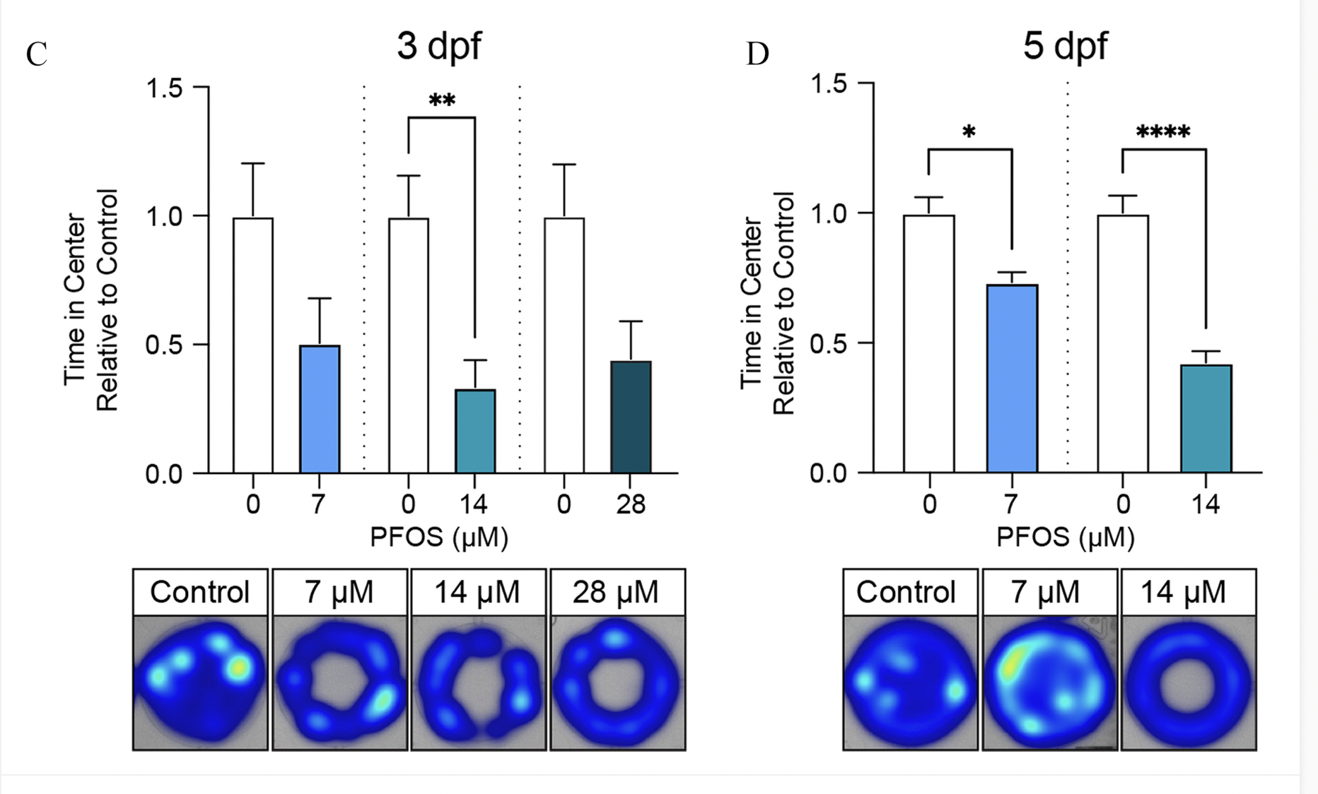
MENTAL HEALTH EFFECTS OF PER- AND POLYFLUOROALKYL SUBSTANCES
Students: Tasneem Ahsan¹, Ryan Li¹, Sabrina Musovic¹, and Alexis Dorval²
Faculty Mentors: Dr. Jihyun Kim², Dr. Shiryn Sukhram¹
¹Department of Biology, College of Staten Island, Staten Island, NY
²Department of Science, Guttman Community College, New York, NY
ABSTRACT:
PFAS are a combination of resistant organic pollutants which are structurally diverse in their chemical composition, as it pertains to being partially (poly-) or fully (per-) fluorinated in a chain of carbon atoms. The characteristics most unique to all PFAS is their hydrophobic and hydrophilic properties in their fluorinated alkyl tail functional group respectively. Hence, making them amphiphilic compounds. PFAS have been a great cause for concern to people around the world due to their ubiquity, whilst causing grave neurological damages to humans through direct or indirect exposure. Because PFAS have carbon-fluorine bonds, it makes them the shortest and strongest bonds known to man and significantly increases their resistance to environmental breakdown. Thus, regarding them as “forever chemicals”. The bioaccumulation of these chemicals in humans over time due to environmental exposure has been reported to be found in blood and different brain areas. The brainstem, which is densely populated in dopaminergic neurons, has been reported to have a major accumulation of PFAS of those in polluted areas. There are significant gaps in the literature relative to the assessment of the nigrostriatal system which entails the striatum and ventral midbrain, among other regions associated with PFAS- associated neurologic dysfunction observed in humans. Extensive evaluated research has shown that there are highly reproduced increased glutamate levels in the hippocampus and catecholamine levels in the hypothalamus and decreased dopamine in the brain after exposure. Future studies are needed to assess the impact of PFAS on the mechanism of neurotransmission and their effects.
RESULTS
At blood serum concentrations above 39.66ng/mL, there is a positive correlation between PHQ-9 Quick Depression Assessment scores and PFAS concentrations
PFOA is closely associated with depression. PR=1.97 (CI95%: 1.06–3.69) regardless of adiposity status
Higher psychological distress in PFAS-contaminated communities than in comparison communities
Risk of PFAS serum contamination results in distress, rather than actual PFAS exposure
PFAS contamination instilled distrust, stress, and anxiety within communities
Financial uncertainty also found to be associated with PFAS
Among immigrant women, PFOS and Me-PFOSA-AcOH has higher CES-D scores PFOS PR=2.7 CI=[0.7-4.7] Me-PFOSA-AcOH PR=2.9 CI=[1.2-4.7]
Increasing all PFAS by one quartile is associated with greater CES-D scores
INTRODUCTION
PFAS, a widespread group of synthetic compounds, has been in use since the 1950s, earning the nickname "forever chemicals" for their long-lasting environmental presence
According to the CDC, 97% of Americans have detectable levels of PFAS in their blood serum, potentially heightening risks related to cancer, fertility, child development, and cholesterol
Despite some research on PFAS’s immunotoxic and neurological impacts, knowledge regarding mental health effects, particularly anxiety and depression, remains limited
DISCUSSION
PFAS are capable of penetrating the blood-brain-barrier, and accumulating in the brain leading to ADHD in children, as well as alzheimers and parkinsons in adults
PFAS from water sources along with other external sources have been seen to play a role in increased rates of depression, anxiety, and avoidant behavior in adolescents
Positive association between prenatal PFAS exposure, specifically PFOAs and PFOS, and increased risk of postpartum depression
Exposure of PFAS in dams and zebrafish demonstrated statistically significant abnormalities in anxiety behaviors through observations and calculations recorded from the response assays
Center avoidance indicated heightened anxiety-like behavior, while willingness to cross the center implied a reduced anxiety-like behavior
Figure 1: General structural formula for PFAS
METHODS
The PUBMed database was systematically searched from inception up to March 20th, 2024
Systematic search followed the guidelines outlined in the World Health Organization Rapid Review Guide
No filters were set on the database
Target literature including studies that focused on and analyzed the psychological effects of PFAS, more specifically its effects on anxiety and depression
Studies included for review complimented the following criteria: (a) focused on specifically PFAS, (b) PFAS and their direct linkage to depression and anxiety, (c) focused on adults, and (d) developed their conditions from specifically water contamination
CONCLUSION:
A convincing correlation between PFAS contamination and neurological disorders such as depression and anxiety is highlighted in this comprehensive literature review.
We aim to influence future public health policies and to shed light on the dangers of PFAS exposure
Future studies should aim to solidify and fill in the gaps that are left as a means of enhancing our comprehension of the neurological effects of PFAS
Uncovering the extent of PFAS-induced depression, and examining its effects across diverse age, ethnic, and socioeconomic groups would add to our understanding of the issue
Figure 2: PFAS neurotoxicity associated with depression
CHEMICAL COMPOSITION
The varying number of carbon-fluorine bonds present in PFAS is the strongest known single bond in nature due to the high electronegativity of fluorine, creating a strong electron withdrawing effect, giving rise to its stability and inability to react with other elements
ACKNOWLEDGEMENTS
This research is partially funded by the Louis Stokes Alliances for Minority Participation (LSAMP) program
Figure 3: Increasing concentrations of PFAS associated with anxiety

